Slide 1

Statistical Properties of Spatially Autocorrelated Data
Richard E. Plant
Ch 3: Statistical Properties of Spatially Autocorrelated Data
HARUG! 2022/V/04
Germán A. Fernández

Slide 2
First law of geography
“Everything is related to everything else, but near things are more related than distant things”
Tobler, 1970, p. 236
Cit. Richard E. Plant
#Important concept

Slide 3
Autocorrelation: definition
“Nowadays, data that obey the first law of geography are said to be spatially autocorrelated. The prefix “auto” comes from the Greek word αυτό, meaning “self.” Thus, to say a feature is spatially autocorrelated means etymologically that its attribute values are correlated with attribute values of the same feature at nearby locations.”
Richard E. Plant
#Important concept

Slide 4

Autocorrelation: definition
-1
1
0

Slide 5
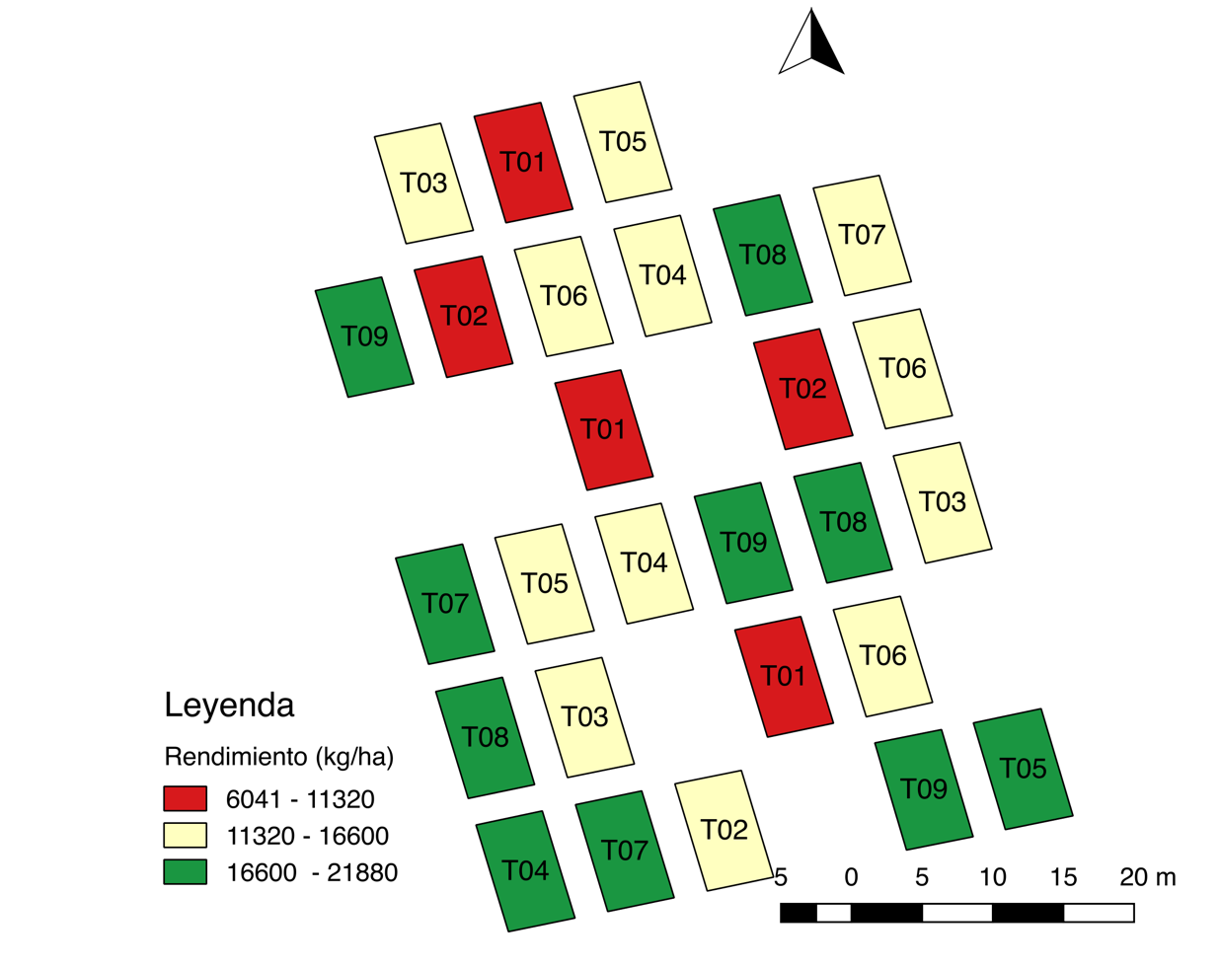
Coordinates
x
6 5 4 3 2 1
(1,4)
6 5 4 3 2 1
y
Leyend
Yield (kg ha⁻¹)

Slide 6
Trends
Leyend
Yield (kg ha⁻¹)

Slide 7
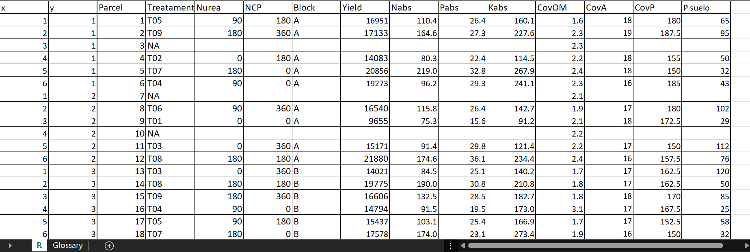
Data

Slide 8
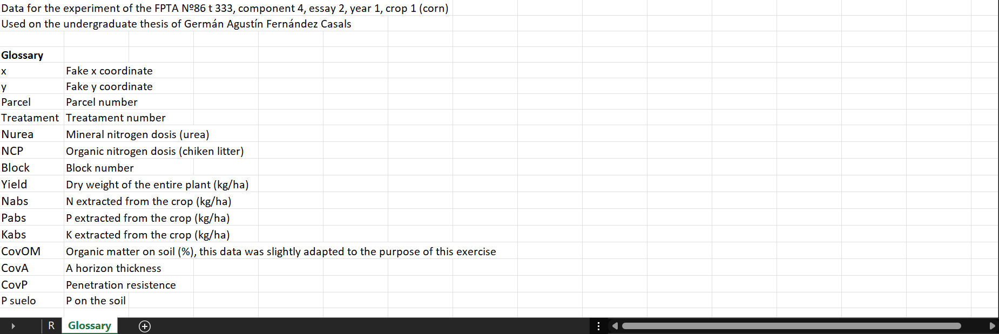
Data

Slide 9
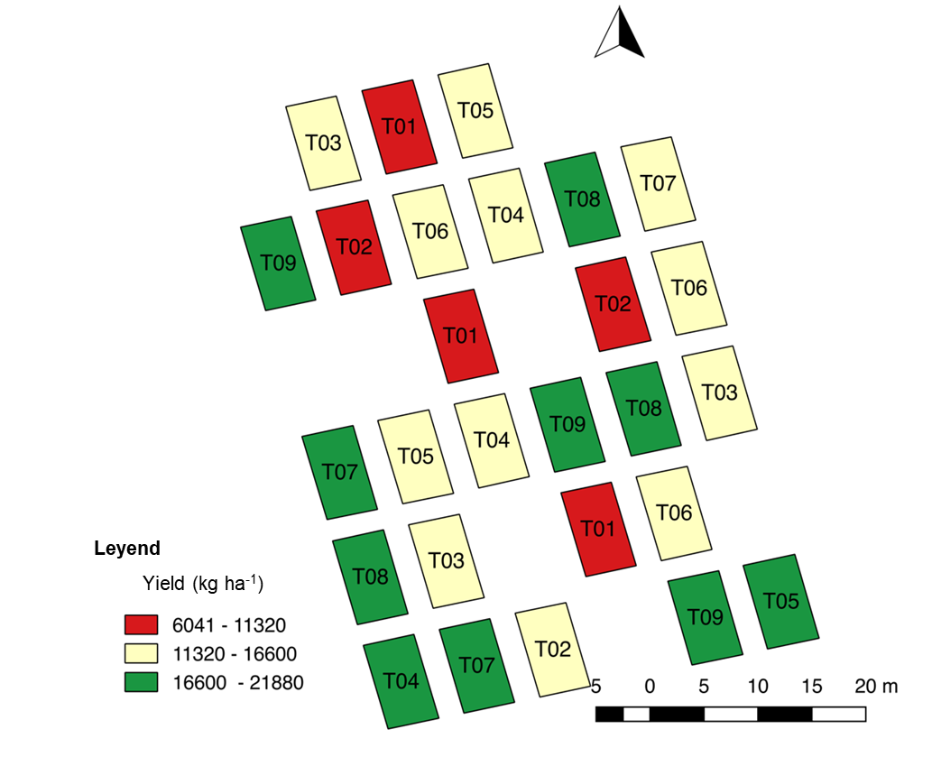
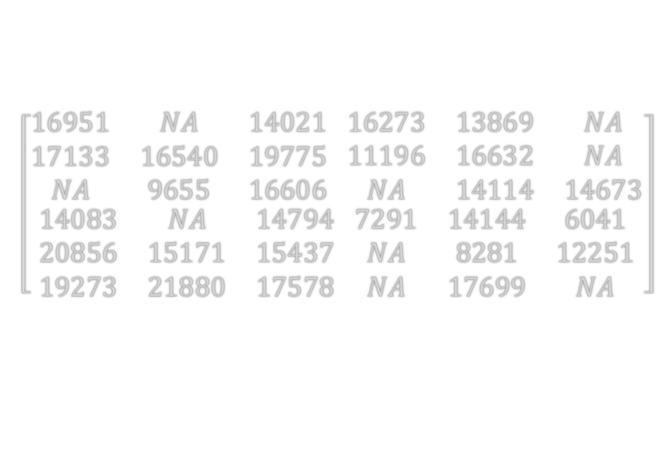
Matrix
Map
Matrix
$$\left[\begin{aligned}\begin{matrix}16951 & NA & 14021 \\ 17133 & 16540 & 19775 \\ NA & 9655 & 16606\end{matrix} \begin{matrix}16273 & 13869 & NA \\ 11196 & 16632 & NA \\ NA & 14114 & 14673\end{matrix} \\ \begin{matrix}14083 & NA & 14794 \\ 20856 & 15171 & 15437 \\ 19273 & 21880 & 17578\end{matrix} \begin{matrix}7291 & 14144 & 6041 \\ NA & 8281 & 12251 \\ NA & 17699 & NA\end{matrix}\end{aligned}\right]$$

Slide 10
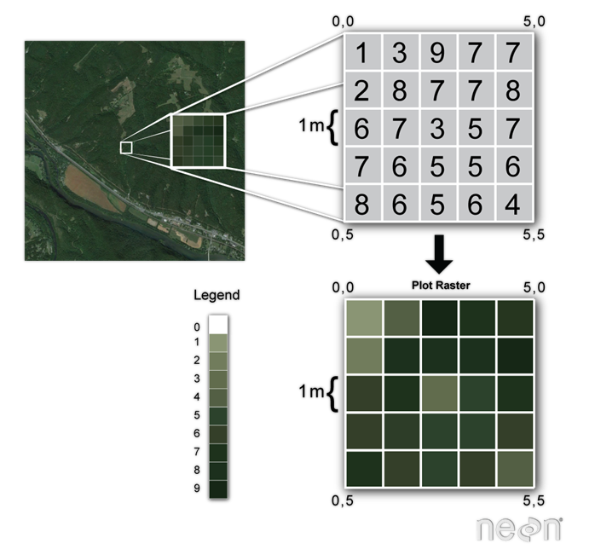
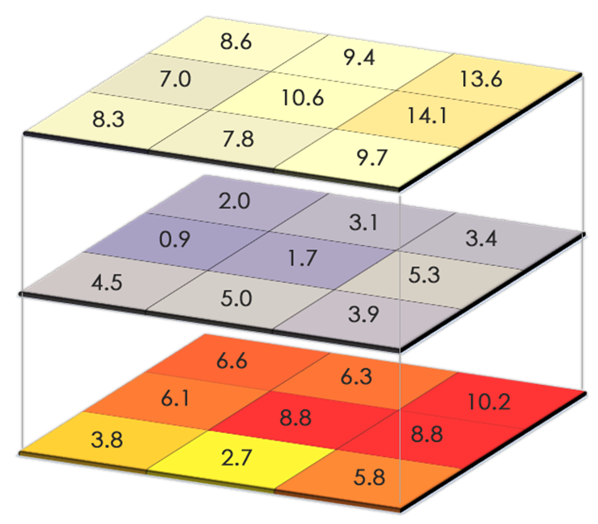
Matrix
Single band
Multi band

Slide 11
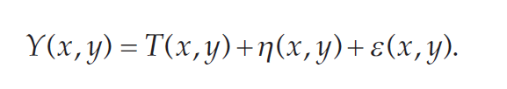
Trends
Uncorrelated random variable
Deterministic trend
Deterministic trend
Spatially autocorrelated random process

Slide 12
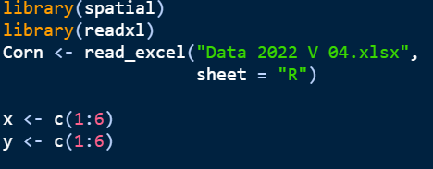
Trend
#Data load

Slide 13

Trend
#Real data plot

Slide 14
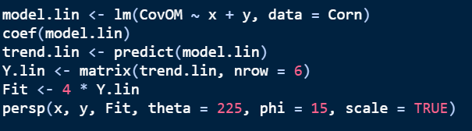
Trend
#Trend calculation and plot

Slide 15
Trends
Real
Trend

Slide 16
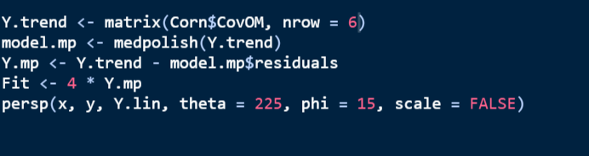
Trend
#Trend calculation and plot
#Other way

Slide 17
Previous concepts
Monte Carlo
Repeat an experiment several times
Observe the mean, the sd and the distribution
On R use the function replicate()
Ex.: flipping a coin several times recording each result

Slide 18
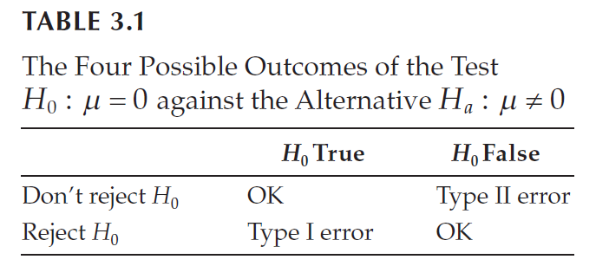
Previous concepts
Student's t-test
Used to compare the means between two groups
On R use the function ttest()

Slide 19
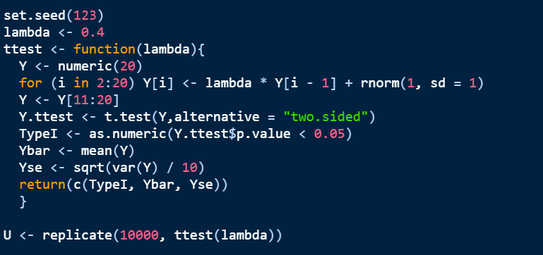
Autocorrelation: little experiment

Slide 20
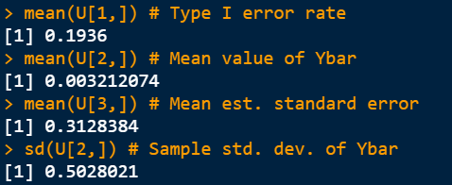
Autocorrelation: little experiment
False positive more than 0.05
Reject the null hypothesis more often than the theory predicts

Slide 21
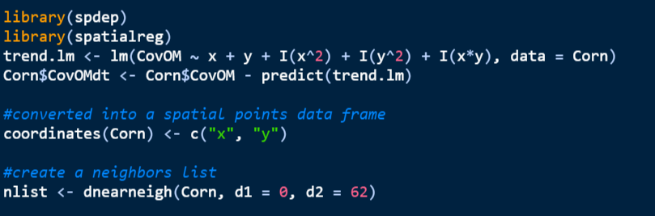
Autocorrelation

Slide 22
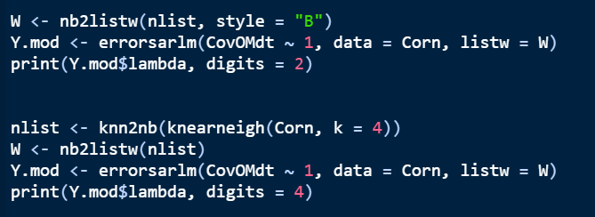
Autocorrelation
# λ = 0.8825
# λ is lambda

